Slide 1
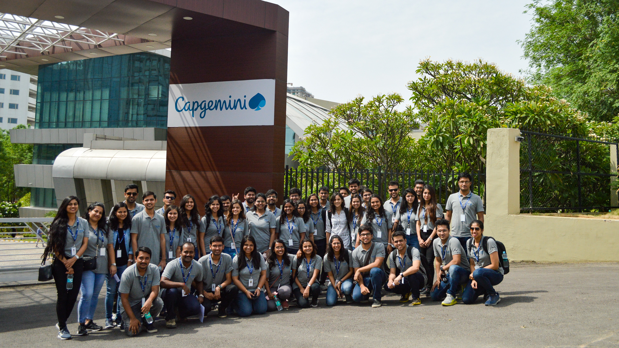

A Comprehensive Study of Capgemini Employee Reviews
SCHOOL OF ENGINEERING AND SCIENCE
DEPARTMENT OF APPLIED SCIENCE AND HUMANITIES
S.Y M.Sc. (Applied Statistics – Data Science)
22MSDS422: Capstone Major Project
Presented By
Suraj R. Jagtap MITU22MSDS0012
Rohit M. Dixit MITU22MSDS0025
Under the Guidance of
Prof. Rohit Raskar

Slide 2

Index
Introduction
Objectives
Data Pre-processing
- Data Description
Exploratory Data Analysis
Analysis Using Software
Conclusion

Slide 3
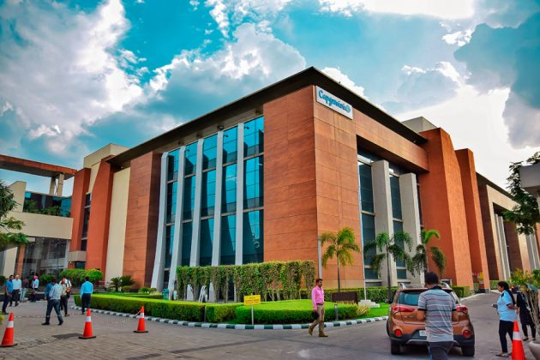
Introduction
Capgemini is a leading company in consulting, technology services and digital transformation.
The company is known for its innovative and cutting-edge solutions.
Capgemini attracts top talent from around the world due to its diverse portfolio.
The experiences of Capgemini employees shape the work environment and reputation of the company.
Capgemini Employees Reviews dataset is a valuable resource to understand employee satisfaction and company culture.

Slide 4

Objectives
To identify the trends and patterns of employee satisfaction.
To identify the primary factors affecting on Employee satisfaction.
To develop a natural language processing (NLP) model to extract keywords from product description.
Develop a recommendation system that offers tailored suggestions.
To develop a Multiclass Sentiment Classification model that classifies employees rating as Positive, Negative and Neutral.
Notes:
© Copyright Showeet.com – Free PowerPoint Templates

Slide 5
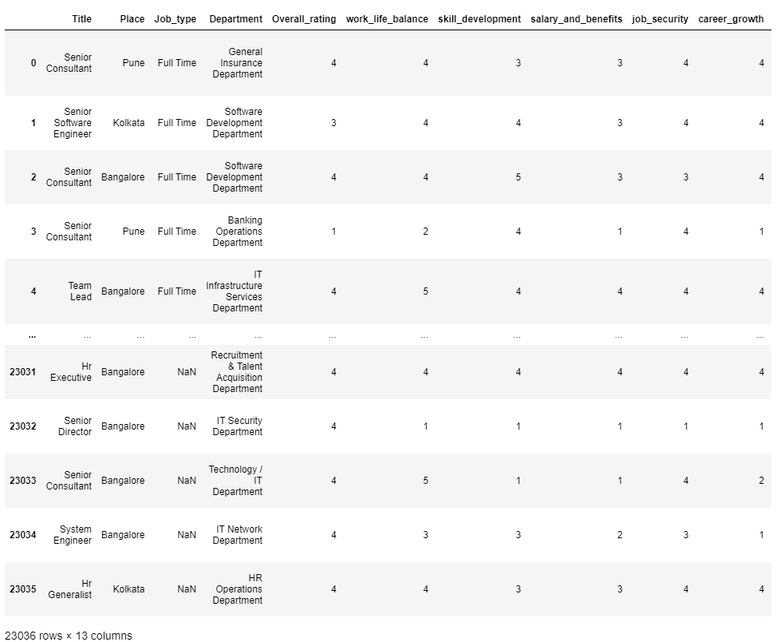
Data Description
Here is short overview of Data:
Source: Kaggle.com
Link: https://www.kaggle.com/datasets/manishkr1754/capgemini-employee-reviews-dataset

Slide 6
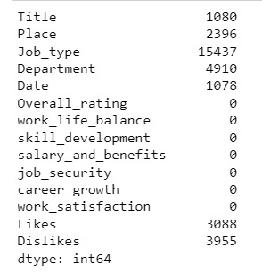
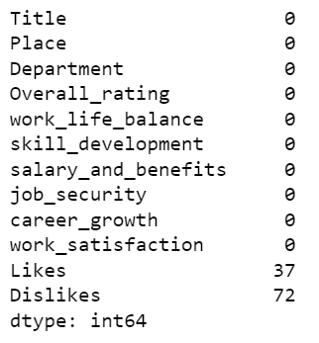
Data preprocessing
Data Cleaning : This involves identify and correcting errors or inconsistent present in the data.
Dealing with missing values: We deleted the missing values rows because we cant replace that missing values.

Slide 7
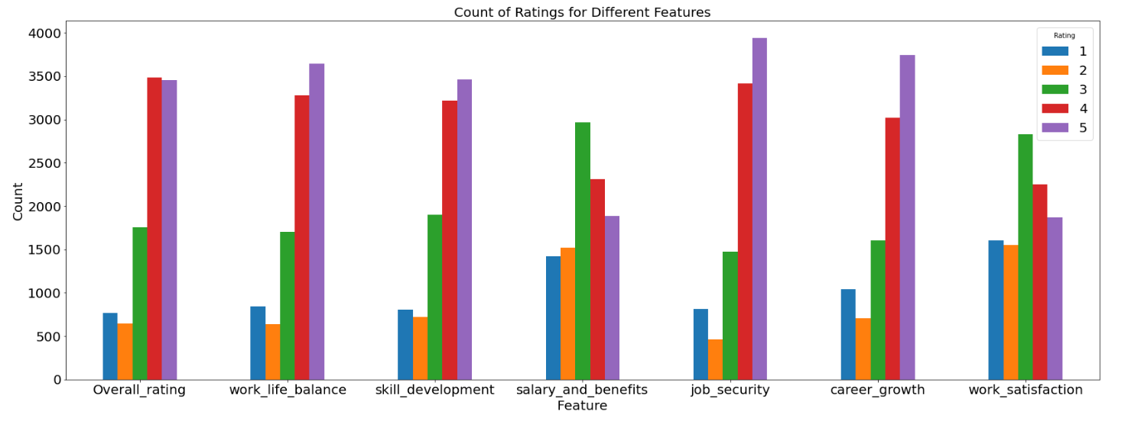
Count Plot of ratings for different features
Exploratory Data Analysis
Interpretation:
In work life balance, job security and career growth the employees gives mostly positive rating that means they are satisfied with the company with these features.
The salary benefit and work satisfaction contains the mostly neutral counts of the employees.

Slide 8
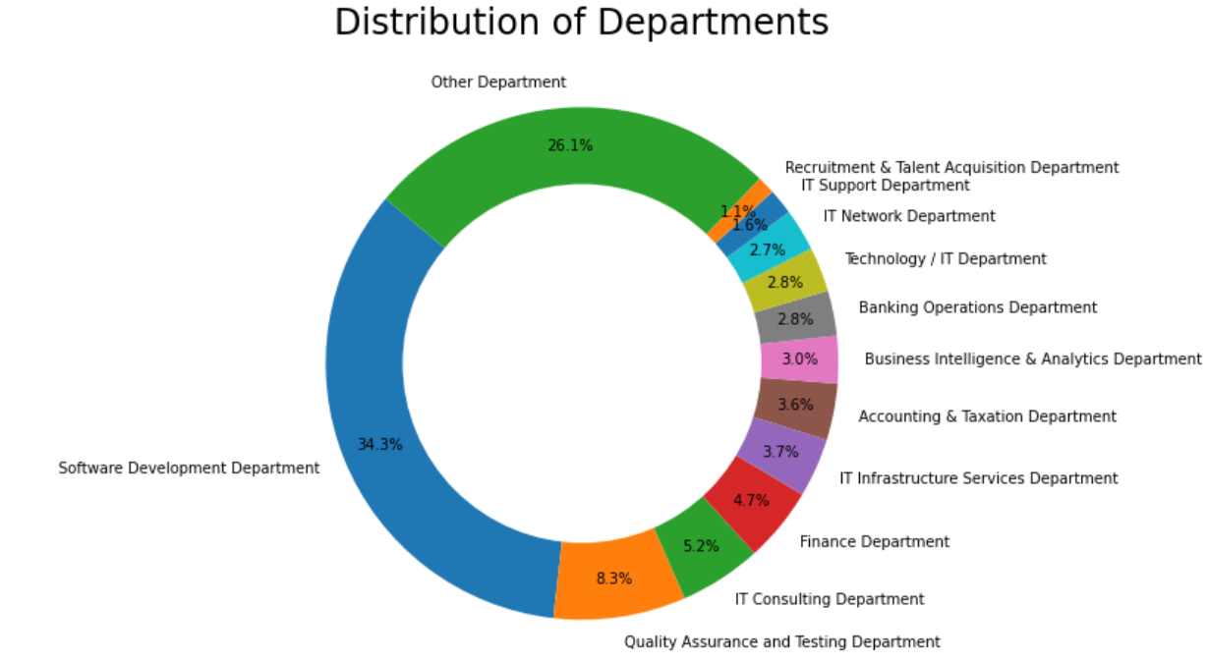
Donut Plot of Employees in department
Interpretation:
In this pie chart, the software development department has the most employee count that is 34.3%.
The 26.1% employee in the Capgemini company work in the other departments like, Telecom department, Marketing department, cyber security, resource management etc.

Slide 9
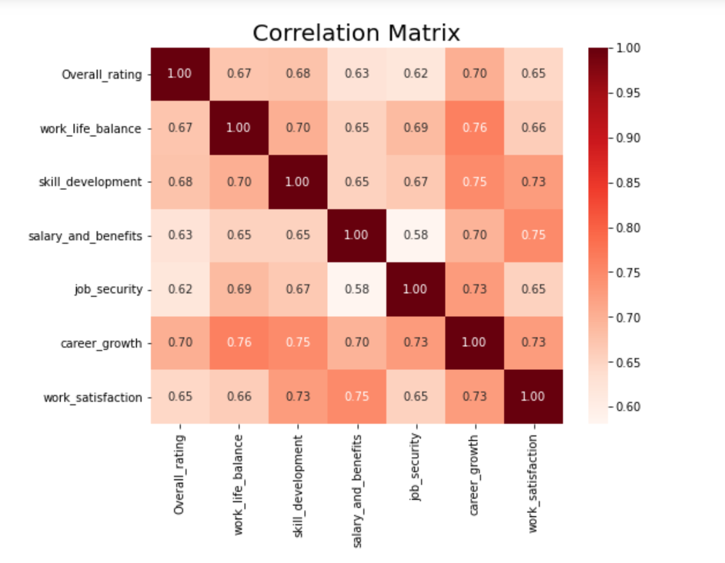
Heatmap
The strong correlation in between career growth and work life balance is (0.76).
The weakest correlation between salary and benefits and job security(0.58).
This means that employees who are satisfied with their jobs also satisfied with other aspects of their work such as work life balance, skill development, salary and benefits.
Notes:
© Copyright Showeet.com – Free PowerPoint Templates

Slide 10
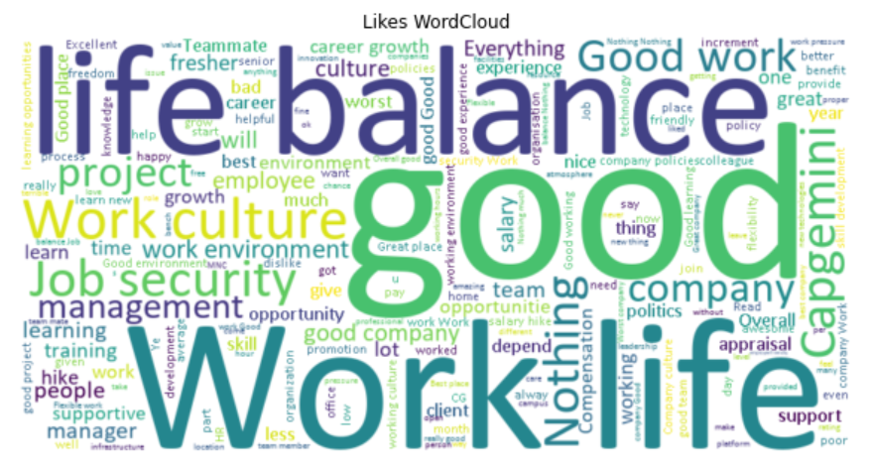
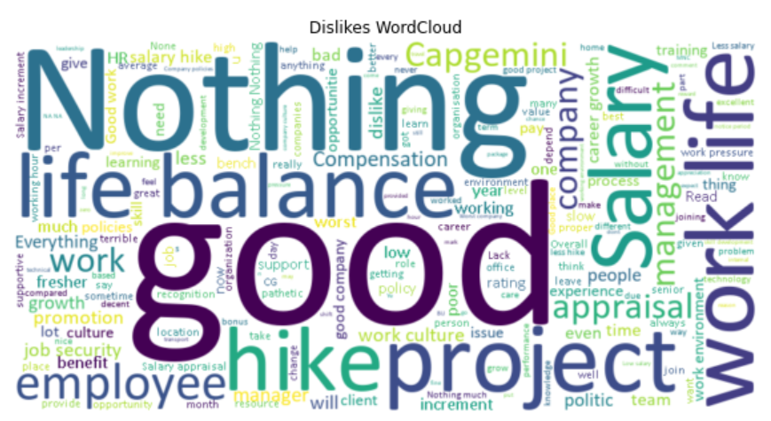
Word Cloud
Word Cloud For Likes
Word Cloud For Dislikes

Slide 11
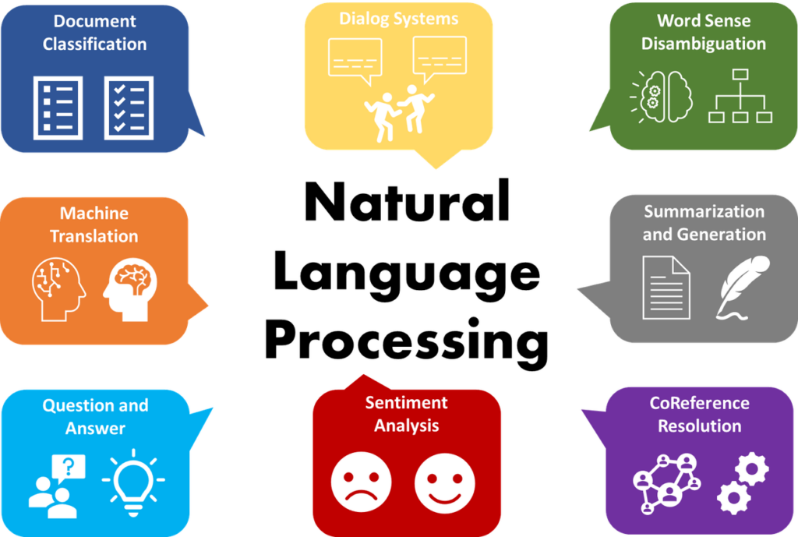
Natural language processing model
Natural Language Processing (NLP) model:
Natural language processing (NLP) is a field of computer science that deals with the interaction between computers and human language.
The goal of NLP is to understand the human language to computers, generate, and manipulate human language in a way similar to how humans.
Applications:
Machine translations
Text Summarization
Cluster Classification
Search engines
Customer service
Data analysis

Slide 12
Extract key words from likes and dislikes
Rank | Description | Keywords | TfIdf_Scores
22193 | NothingPolicy is not good | Work | 3.260481
8947 | This Organization Conduct good learning sessio... | Good | 1.822455
4547 | Salary on time.\nMNC Work culture\nWork life b... | Is | 1.536754
3700 | Good to work under this companyi didn't face a... | Security | 0.893850
508 | As a fresher it is good companyFor experienced... | Job | 1.133523
6697 | CultureAppraisal\nWork culture\nJob security | Salary | 1.036641
11109 | Salary appraisalNA. There is nothing which I d... | Like | 1.073958
4061 | Nothing I like.No job security here plus bad e... | Not | 1.380125
20427 | Good work place and they follow the ethicsEmpl... | No | 1.536754
2226 | Job security and work life balancePoor hikes, ... | Life | 3.276802

Slide 13

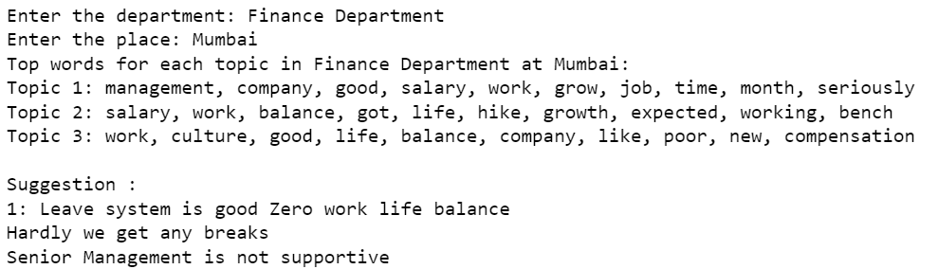
Employees suggestion system
Develop a recommendation system that offers tailored suggestions based on Department and Place.
Consider one example for Suggestion
Suggestion = Department: Finance Department
Place: Mumbai

Slide 14
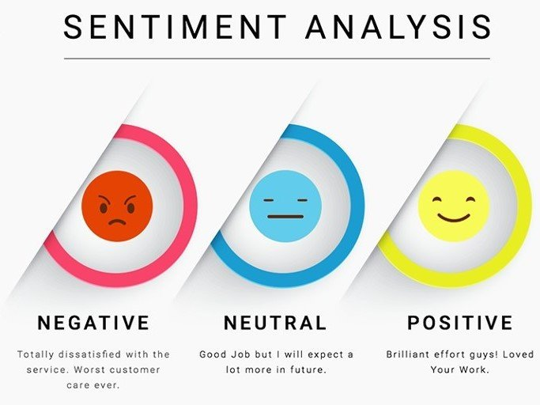
Sentiment Analysis
Sentiment analysis is a technique used to determine the sentiment or emotion expressed in a piece of text, such as a review, comment, or social media post.
It involves analysing the words, phrases, and context of the text to understand whether the sentiment is positive, negative, or neutral.
Some of the most common methods of sentiment Analysis:
Lexicon-based methods
Machine learning methods
Hybrid methods
Notes:
© Copyright Showeet.com – Free PowerPoint Templates

Slide 15
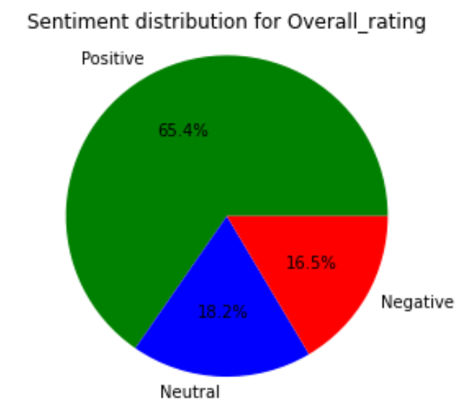
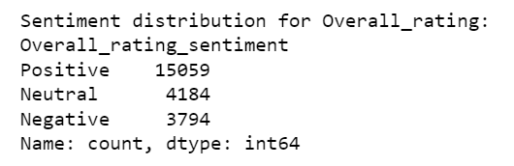

To develop a multi-class sentiment classification model.
Ratings | Sentiment
1 to 2 | Negative Sentiment
3 | Neutral Sentiment
4 to 5 | Positive Sentiment
So, by observing the count of sentiments we can say that our data is imbalance so we have to handle the imbalance dataset by using the techniques.
Notes:
© Copyright Showeet.com – Free PowerPoint Templates

Slide 16
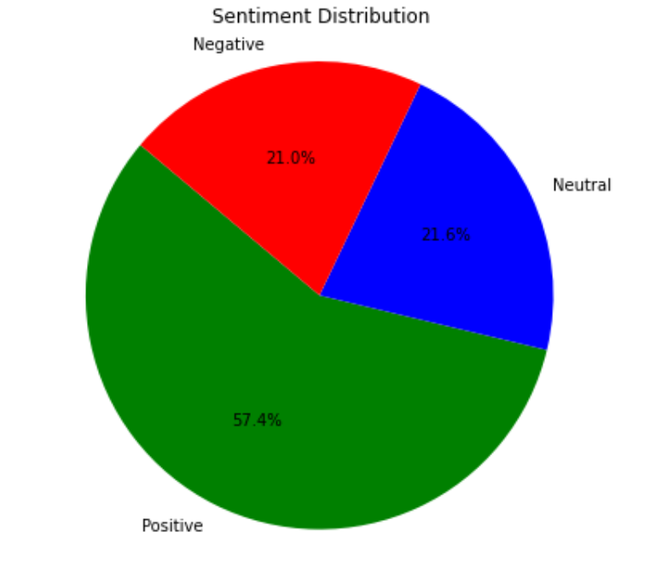
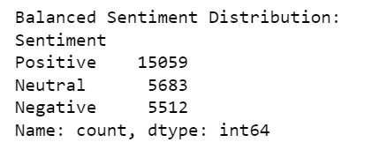
Random Over-Sampling
Here we implement the Random Over-Sampling technique to handle the imbalance sentiment class present in the data. So, by using the Over-sampling method it balance the number of neutral sentiment and number of negative sentiments and positive sentiment class remain same as shown in above pie diagram.
Notes:
© Copyright Showeet.com – Free PowerPoint Templates

Slide 17
To develop a Multiclass Sentiment Classification model that classifies employees rating as Positive, Negative and Neutral.
Multinomial logistic regression: Multinomial logistic regression (MLR) is a versatile algorithm uses for multi-class classification tasks. It extends logistic regression to handle multiple target classes by employing a SoftMax function, making it suitable for sentiment analysis and other text classification tasks.
Multinomial Naive Bayes: Multinomial Naïve Bayes is a simple and effective ML algorithm commonly used for sentiment analysis. It is based on Bayes' theorem, which provides a framework for calculating probabilities based on conditional statements. In the context of sentiment analysis, Multinomial Naïve Bayes is used to classify texts into pre-defined sentiment categories, such as negative, positive or neutral.
LSTM: Long short-term memory is an important intermittent RNN armature designed to overcome the evaporating grade problem. With specialized memory cells, it effectively captures long-range dependencies in sequential data like texts, making it ideal for analysis of sentiments and other NLP tasks.
Accuracy | 0.769948
Accuracy | 0.785183
Accuracy | 0.790516

Slide 18
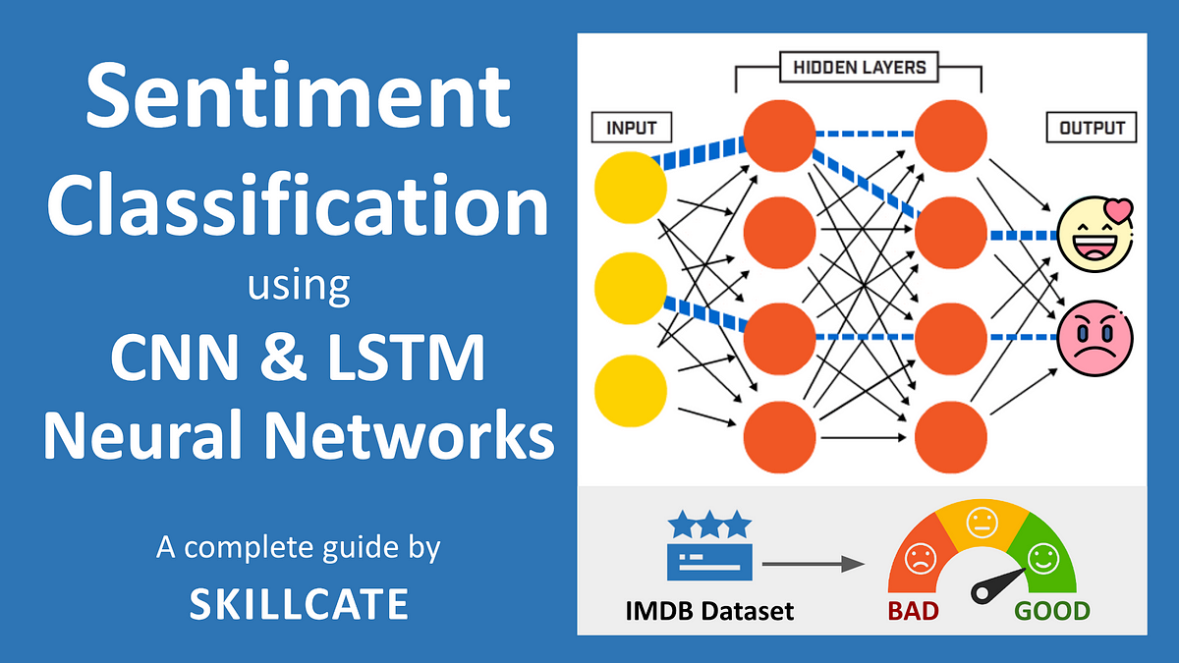
Sentiment Analysis using LStm
LSTM is a type of recurrent neural network (RNN) that is particularly effective for analyzing sequences of data, making it well-suited for tasks like sentiment analysis, where the order of words in a sentence matters.
Notes:
© Copyright Showeet.com – Free PowerPoint Templates

Slide 19
Sentiment Analysis using LSTM
Output:
Classification Report:
Accuracy | 0.790516
Interpretation:
LSTM model has the highest accuracy among the three models. Therefore, the conclusion would be that the LSTM model performs more accurate than both the Naive Bayes and Multinomial Logistic Regression models for sentiment analysis.
Column1 | Precision | recall | F1-score | Support
Negative | 0.78 | 0.77 | 0.77 | 1120
Neutral | 0.59 | 0.54 | 0.56 | 1113
Positive | 0.86 | 0.89 | 0.88 | 3018
Accuracy |  |  | 0.79 | 5251
Macro avg | 0.74 | 0.73 | 0.73 | 5251
Weighted avg | 0.79 | 0.79 | 0.79 | 5251

Slide 20
Conclusion
We can conclude that factors like work and life balance, development of skills, benefits and salary, security of job, and growth of career positively impact employee work satisfaction, leading to increased job satisfaction.
We can conclude that employees generally satisfied with work-life balance, job security, and career growth, but neutral ratings for salary benefits and work satisfaction suggest that these areas may require improvement or further attention from the company.
We can conclude that NLP is technique used to extract keywords from text by identifying the most important and relevant words and phrases based on TF-IDF scores.
We can Build suggestion system based on department and place which can suggest the nature of the company.
We can conclude that the overall accuracy of the LSTM is 0.7905, indicating that it correctly classified 79.05% of the employee’s ratings. This is a relatively high accuracy, suggesting that the classification is able to effectively distinguishing between positive, negative, and neutral sentiments.

Slide 21

Thank You………
Notes:
© Copyright Showeet.com – Free PowerPoint Templates

